Slide 1

CSCI 3700/6070: IMDb Project Report
Group 6
Ernesto Contreras
Brandon Litzinger
Kayla Luther
Alex Maynard
Joanna Sumner
Notes:
Presenter: Brandon
Introduce group members and note that Ernesto is a late addition to the team.
Kayla Luther: Group Leader
Joanna Sumner: Assistant Group Leader
Ernesto Contreras: Contributor
Brandon Litzinger: Contributor
Alex Maynard: Contributor

Slide 2

Project Roadmap
Step 1
Design Database Schema
Step 2
Load Database
Step 3
Design Various Queries
Step 4
Design Web Application
Step 5
Test, Polish, and Demo Application
Step 0
Choose Platforms
Notes:
Presenter: Brandon
Like any computer program, we start with Step 0. These are the steps we went through. When we gave our last report, we had finished step 3 and had begun step 4. We’ll provide more details regarding step 4 and 5, while reviewing those we’ve already completed.
We are completing step 5.

Slide 3
Step 0: Choose Platforms
Database: MySQL 8.0
Familiar, Easy-to-Use
8.0 supports common table expressions (“WITH tablename …”)
Web Application
Server: Wamp
Design: Bootstrap
Code: PHP Scripts following MVC Design Method
Notes:
Presenter: Brandon
MySQL 5.7 (the release before 8.0) did not support the “WITH” clause. The with clause helps make queries more efficient and easier to read, and we utilized the clause, so we needed a MySQL version that supported it.
Used a Wamp server on our computers to host the application
Using Bootstrap made the application design easier. We only had a very small CSS file for customization
One of the reasons we chose the wamp server and php is because Kayla already had experience with them.

Slide 4
Step 1: Design Database Schema
aka
titleID
ordering
title
region
language
types
attributes
isOriginalTitle
aliases
name
director
nconst
primaryName
birthYear
deathYear
primaryProfession
title
tconst
titleType
primaryTitle
originalTitle
isAdult
startYear
endYear
runTimeMinutes
genres
writer
knownForTitles
parentTconst
ordering
category
job
characters
episode
principals
tconst
averageRating
numVotes
seasonNumber
episodeNumber
Notes:
Presenter: Alex
It’s helpful to look at an ER diagram to get the big picture.
This ER diagram also helps identify the keys necessary for each table. We identified primary keys for each table as well as foreign keys to provide links between tables.
There are three entities represented in the dataset: name, title, and aka.
The entity name is represented by the name_basics table.
The entity title is represented by the title_basics and title_ratings table. The rating information is technically part of the title entity, but it is probably stored separately in the IMDb dataset because the rating information must be pulled from another database.
The entity aka (also known as titles) is represented by the title_akas table. This table is directly related to the title table. The aka entity provides multiple aliases for each title.
The name and title tables are related by four relationship sets: director, writer, knownForTitles, and principals. The director and writer relationships are represented by the title_crew table.
The knownForTitles relationship is included in the name_basics table.
The principals relationship is represented by the title_principals table.
Each episode relationship is between two unique titles in the title set. The episodes relationship is represented by the title_episode tables.

Slide 5
Step 1: Design Database Schema
title_ratings
tconst | varchar(10)
averageRating | double
numVotes | mediumint(255)
PRIMARY KEY(tconst)
FOREIGN KEY(tconst) REFERENCES title_basics(tconst)
name_basics
nconst | varchar(10)
primaryName | varchar(255)
birthYear | smallint(4)
deathYear | smallint(4)
primaryProfession | varchar(255)
knownForTitles | varchar(255)
PRIMARY KEY(nconst)
title_akas
titleID | varchar(10)
ordering | int(2)
title | varchar(2000)
region | char(5)
language | char(25)
types | varchar(30)
attributes | varchar(200)
isOriginalTitle | boolean
PRIMARY KEY(titleId, ordering)
FOREIGN KEY(titleId) REFERENCES title_basics(tconst)
Schema mirrors dataset description
Challenges
Determining attribute type and size
Handling arrays
title_principals
tconst | varchar(10)
ordering | int(2)
nconst | varchar(10)
category | varchar(255)
job | varchar(1000)
characters | varchar(1000)
PRIMARY KEY(tconst, nconst)
FOREIGN KEY(tconst) REFERENCES title_basics(tconst)
FOREIGN KEY(nconst) REFERENCES name_basics(nconst)
title_basics
tconst | varchar(10)
titleType | varchar(255)
primaryTitle | varchar(500)
originalTitle | varchar(500)
isAdult | boolean
startYear | smallint(4)
endYear | smallint(4)
runtimeMinutes | double
genres | varchar(50)
PRIMARY KEY(tconst)
title_episode
tconst | varchar(10)
parentTconst | varchar(10)
seasonNumber | int(2)
episodeNumber | mediumint(255)
PRIMARY KEY(tconst)
FOREIGN KEY(tconst) REFERENCES title_basics(tconst)
FOREIGN KEY(parentTconst) REFERENCES title_basics(tconst)
title_crews
tconst | varchar(10)
directors | varchar(4500)
writers | varchar(11700)
PRIMARY KEY(tconst)
FOREIGN KEY(tconst) REFERENCES title_basics(tconst)
Notes:
Presenter: Alex
With the ER diagram in mind…
We utilized the descriptions of the IMDb Dataset to develop a database schema. Thus, our design essentially mirrored the dataset that was given.
Created a corresponding table in our database for each table in the dataset.
In designing the schema, we encountered two challenges
Challenge 1: The types for each table’s attributes/columns were determined from the dataset description, but it did require some trial and error to determine the correct field width for some of the columns.
Challenge 2: Many of the tables have columns which hold an array of values. For those columns where the values held were tconsts or nconsts, the unique identifiers used for titles and people, we considered several different methods for ensuring easy access.
We considered creating an interim table for each column containing an array of values in the title_crew table and the name_basics table. For example, the title_crew table would be split into two tables: title_director and title_writer. Each record in each table would hold a tconst (identifying a title) and an nconst for either a director or writer as appropriate. The tables could hold multiple directors or writers for one title. This would enable us to constrain the information in the title_crew and name_basics to link to foreign keys. In addition, the values could all be indexed which would allow for more efficient access.
Though the first option would be more efficient in the long run, our group decided it wasn’t feasible for us given our time constraints in trying to setup our database. Thus, we chose to keep all values from an area in a single field with values separated by commas. This doesn’t allow the values to be used directly as foreign keys, but a SQL script can be utilized to extract the values from the array and use to fulfill necessary questions.

Slide 6
Step 2: Load Database
Example PHP Script: Load title_basics
<?php
set_time_limit(0);
$servername = "localhost";
$username = “username";
$password = "password";
$dbname = "imdb";
// Create connection
$conn = new mysqli($servername, $username, $password, $dbname);
// Check connection
if ($conn->connect_error) {
die("Connection failed: " . $conn->connect_error);
}
'<br />';
echo "Connected successfully";
//TITLE.BASICS TABLE
$sql = "LOAD DATA INFILE '/wamp64/www/imdbWebApp/title.basics.tsv' INTO TABLE title_basics LINES TERMINATED BY '\n' IGNORE 1 LINES";
if (mysqli_query($conn, $sql)) {
echo "New Tables created successfully";
} else {
echo "Error: " . $sql . "<br>" . mysqli_error($conn);
}
'<br />';
$conn->close();
?>
CREATE tables using PHP script
LOAD tables individually using PHP scripts
PHP Script Outline
Create connection
Check connection
Create Table or Load data
Load Data Example
$sql = "LOAD DATA INFILE '/wamp64/www/imdbWebApp/title.basics.tsv' INTO TABLE title_basics LINES TERMINATED BY '\n' IGNORE 1 LINES";
Close connection
Challenge: Timeout during data loading
set_time_limit(0);
Notes:
Presenter: Ernesto
We previously described how we loaded the database using a PHP script that utilized the LOAD DATA INFILE function from PHP. We have not changed anything about how the data was loaded.
We loaded the dataset into a MySQL database using PHP scripts.
The basics steps of the script are outlined.
The function to load data automatically replaced the values marked ‘\N’ with the NULL value.
When loading the data, we initially ran into a problem with the scripts timing out because loading the data took a while for some tables. To fix this, we set the time limit to false so the connection would not time out.

Slide 7
Step 3: Design Various Queries
Task: Design three sets of queries
3 specific queries
4 queries using specific techniques
5 queries using views and stored procedures
Techniques
Identify the tables involved and join them
Determine conditions for data
Select specific attributes desired
Optimize using common expressions, views, or stored procedures
Challenges
Extract data from array attribute (example: knownForTitles)
Use common expression (WITH table…) and extract using SUBSTRING_INDEX function
Notes:
Presenter: Ernesto
We designed a total of 12 queries including the three specific queries and four specific query techniques specified by Dr. Gao. We also design 5 bonus queries.
When designing the queries, we used the following method:
Identify the tables involved and join these tables
Determine the conditions for the data (for example: title type must be movie or titles must have a certain minimum rating)
Select the specific attributes desired in the output
Finally, after getting a query to work, sometimes we’d be able to reform it to make it simpler or convert it to utilize a view or procedure
The only particularly difficult part of doing the queries was to extract data from the array values that had been stored in a single field. For example, the knownForTitles attribute of the name_basics table. But this was easily accomplished by extracting the values needed using the SUBSTRING_INDEX function and placing them in a common expression (using the WITH table expression) so they could be easily utilized in a query.

Slide 8
Step 3: Design Various Queries
Query 1: Show the information of movies (Title, Region, Language, Year, Rating, Votes) which have average rating greater than 7 and number of votes greater than 1000.
SELECT title,region,language,startYear,averageRating,numVotes
FROM (title_akas JOIN title_basics ON title_akas.titleId = title_basics.tconst)
JOIN title_ratings ON title_ratings.tconst = title_basics.tconst
WHERE averageRating > 7 AND numVotes > 1000 AND titleType ='movie' AND ordering = 1
ORDER BY averageRating DESC;
Query 2: Show the names of persons who have directed more than 10 movies.
SELECT nconst, primaryName, count(*) AS Total
FROM ( (SELECT tconst FROM title_basics WHERE titleType='movie') AS titles
JOIN (SELECT tconst, nconst FROM title_principals WHERE category='director') AS directors
USING (tconst) )
JOIN name_basics USING (nconst)
GROUP BY directors.nconst
HAVING Total >10;
Query 3: Show the top 10 TV series (more than 1 season) which most average ratings.
SELECT tconst, primaryTitle, rating FROM
title_basics JOIN
(SELECT parentTconst, AVG(averageRating) AS rating FROM title_episode JOIN title_ratings USING(tconst)
GROUP BY parentTconst
HAVING SUM(DISTINCT seasonNumber) > 1) AS series_ratings
ON title_basics.tconst=series_ratings.parentTconst
ORDER BY rating DESC LIMIT 10;
Notes:
Presenter: Joanna
Here are the queries we designed to fulfill Dr. Gao’s requirement.

Slide 9
Step 3: Design Various Queries
Query 4.1: Use aggregate functions, “group by” and “order by”.
Query Objective: Determine the number of each titleType stored in the IMDB and list the types with the most titles first. In other words, determine how many movies, tv episodes, shorts, etc. are in the database.
SELECT titleType, COUNT(*) AS typeCount
FROM title_basics
GROUP BY titleType
ORDER BY typeCount DESC;
Query 4.2: Use set operations.
Query Objective: Select all titles originally released for the US or Great Britain. Note their language and release year.
SELECT title, region, language, startYear FROM
((SELECT titleId, title, region, language FROM title_akas
WHERE region='US' AND isOriginalTitle=1)
UNION
(SELECT titleId, title, region, language FROM title_akas
WHERE region='GB' AND isOriginalTitle=1)) AS title_info
JOIN title_basics ON title_info.titleId=title_basics.tconst;
Query 4.3: Use nested/sub queries (either in SELECT clause, FROM clause or WHERE clause).
Query Objective: Select individuals who are only known for a single adult title and died after 2005.
SELECT primaryTitle, primaryName, deathYear FROM title_basics
JOIN name_basics ON tconst=knownForTitles
WHERE deathYear IN (SELECT deathYear FROM name_basics WHERE deathYear > 2005)
AND isAdult=1
ORDER BY deathYear;
Query 4.4: Use JOIN operations.
Query objective: Select all titles that were produced in or after 2000 for the US, are in the English language, and are classified only in the fantasy genre.
SELECT DISTINCT title, language, region, genres, startYear
FROM title_akas
JOIN title_basics ON startYear>=2000 AND genres='Fantasy'
WHERE language='en' AND region='US';
Notes:
Presenter: Joanna
And these are the four queries we designed using the four different techniques: aggregate functions, set operations, nested queries, and JOIN operations. Each query focuses on a specific technique, but most of them use several. For example, 9 of our 12 queries require joins.

Slide 10
Step 3: Design Various Queries
Extra Query 1: Show the top 10 longest running tv series.
Run this query on a view which shows the tv series title and years running. */
/* Create the view */
CREATE VIEW tvseries_yearsRunning AS
SELECT tconst AS seriesTconst, primaryTitle, endYear-startYear AS yearsRunning
FROM title_basics WHERE titleType='tvseries';
/* Run the example query */
SELECT * FROM tvseries_yearsRunning
ORDER BY yearsRunning DESC
LIMIT 10;
Extra Query 2: Select the movies titles and ratings for all movies released in a specified year with a rating at or above the specified minimum rating.
This query utilizes a procedure which accepts a year and minimum rating as parameters and selects all the specified titles.
/* Create procedure*/
CREATE PROCEDURE movies_in_year_rating(IN yearSelect SMALLINT(4), IN ratingMin DOUBLE)
BEGIN
SELECT primaryTitle, averageRating
FROM (SELECT * FROM title_basics WHERE titleType='movie' AND startYear=yearSelect) AS movies_in_year
JOIN (SELECT * FROM title_ratings WHERE averageRating >= ratingMin) AS title_with_rating
USING (tconst);
END
/* Call the procedure using example year and minimum rating.*/
CALL movies_in_year_rating(2005, 9.0);
Notes:
Presenter: Joanna
These are 2 of the extra queries we designed. I’d like to highlight the 2nd extra query. This query selects all the movies released in a specific year with a rating at or above a specified minimum rating. To design this query we first determined we needed to join the title_basics and title_ratings table. Then, we determined the conditions for the titles, first selecting movies with a certain year from title_basics and joining these titles with titles from the ratings table that had at least the minimum rating. By specifying conditions before joining the two sets of data, we had a smaller dataset to join. Finally, we selected the attributes we wanted, and turned it into a procedure so that we can call it using the year and minimum rating a user specifies.

Slide 11
Step 3: Design Various Queries
Extra Query 3: Given a name, find all individuals in database with that name and list their information along with title details for one title they are known for.
This query utilizes a procedure that takes a person's name and finds all individuals with that name and titles details for one title each individual is known for.
/* Create procedure*/
CREATE PROCEDURE known_for_title(IN searchName VARCHAR(50))
BEGIN
WITH name_title AS (SELECT nconst, primaryName, primaryProfession,
SUBSTRING_INDEX(knownForTitles, ',', 1) AS tconst
FROM name_basics WHERE primaryName=searchName)
SELECT nconst, primaryName, primaryProfession, titleType, primaryTitle, startYear, endYear
FROM name_title JOIN title_basics USING(tconst);
END
/* Call the procedure using an individual's name.*/
CALL known_for_title('Peter Jackson’);
Extra Query 4: Find all documentaries that relate to the topics of war.
This query utilizes a showing all documentaries.
/* Create the view */
CREATE VIEW documentaries AS
SELECT * FROM title_basics WHERE genres LIKE '%Documentary%';
/* Run the query */
SELECT * FROM documentaries WHERE
primaryTitle LIKE '%War%’;
Extra Query 5: Select all tv series that are comedies.
Use a procedure which will return information about all tv series that are in a specified genre.
/* Create procedure
CREATE PROCEDURE tvseries_genre(IN genre VARCHAR(20))
BEGIN
SELECT * FROM title_basics
WHERE titleType='tvseries' AND genres LIKE CONCAT('%',genre,'%');
END
/* Call the procedure for the comedy genre.*/
CALL tvseries_genre('comedy');
Notes:
Presenter: Joanna
These are the final 3 queries we designed: 2 more procedures and another view.

Slide 12
Step 4: Design the Web Application
Design: Bootstrap Template with Minimal Custom CSS
PHP Scripts for logic and control
Included HTML for Display
MVC Design Method
Challenges
MVC Design Method: Research and revise
Large Queries: Limit top 1000
Slow Queries: Add Database Indexes
Notes:
Presenter: Joanna
After loading the database and finishing the queries, we needed to develop a webapp. Kayla had prior experience creating a website and using PHP, so she lead this effort. She utilized a Bootstrap Template for the design and then specified a few CSS values to customize the look. On individual pages, she also specified a few styles items as needed. PHP scripts provide all the logic and control while HTML is used to create the views.
We following the MVC design method, which Kayla will explain next.
One challenge was learning how to implement the MVC Design method, but some articles found via Google and an example website Dr. Gao showed us helped tremendously.
Also, because some of the queries can return very large datasets, we limited some of the queries to return at a maximum 1000 results.
Finally, because some queries were slow, we added additional indexes on the most used attributes to speed up the query time. These indexes were in addition to the primary keys for each table.

Slide 13





Step 4: Design the Web Application
File Structure and Relationships
MVC Design Method
CSS, images, etc.
header/
footer
Model
Database
home
services
contact
q#_title
form
View
g#_title
Controller
Users
q#_title
database
q#_title
result
users
Notes:
Presenter: Kayla
Our files are structured in the following way:
All files that provide a view, those in orange, utilize the resource folders which include the CSS files dictating the design and any needed images and audio files.
The home, services, and contact pages are the main application views. All view pages utilize the header and footer which provides the navigation bar. The services page is where users can click on links to run different queries. There are two types of queries: independent queries and parameterized queries.
The independent queries are immediately run as soon as a user clicks the link. The parameterized queries require a form page for users to specify certain information, like a year, rating, or person they’re interested in searching, and then this information is passed to the query page and the query is run.
The query pages display the results.
We’ll now provide a little more detail about how our code follows the model view controller design method.
When a query is run, the query page instantiates a controller, an object of the Users class.
This controller then passes a query to the model, the Database. The database runs the query and passes the result back to the view and it’s displayed in the HTML view.

Slide 14
Step 5: Test, Polish, and Demo Application
Initial Web App Developed
Group Review and Updates
Ready for Demo!
Notes:
Presenter: Kayla
Demo application using Kayla’s computer (Joanna’s ready as backup, along with screenshots on slides for additional backup).
Show home page, services page, select queries (quick queries: 3-TopTVSeries, 4.1-TitleTypes, 4.2-USGBTitles, e1-LongestTVSeries, e2-YearRatingMovies, e3-ActorTitle, e4-WarDocumentaries, e5-ComedyTVSeries), and contact page.
And whatever surprises Kayla has up her sleeves ☺

Slide 15
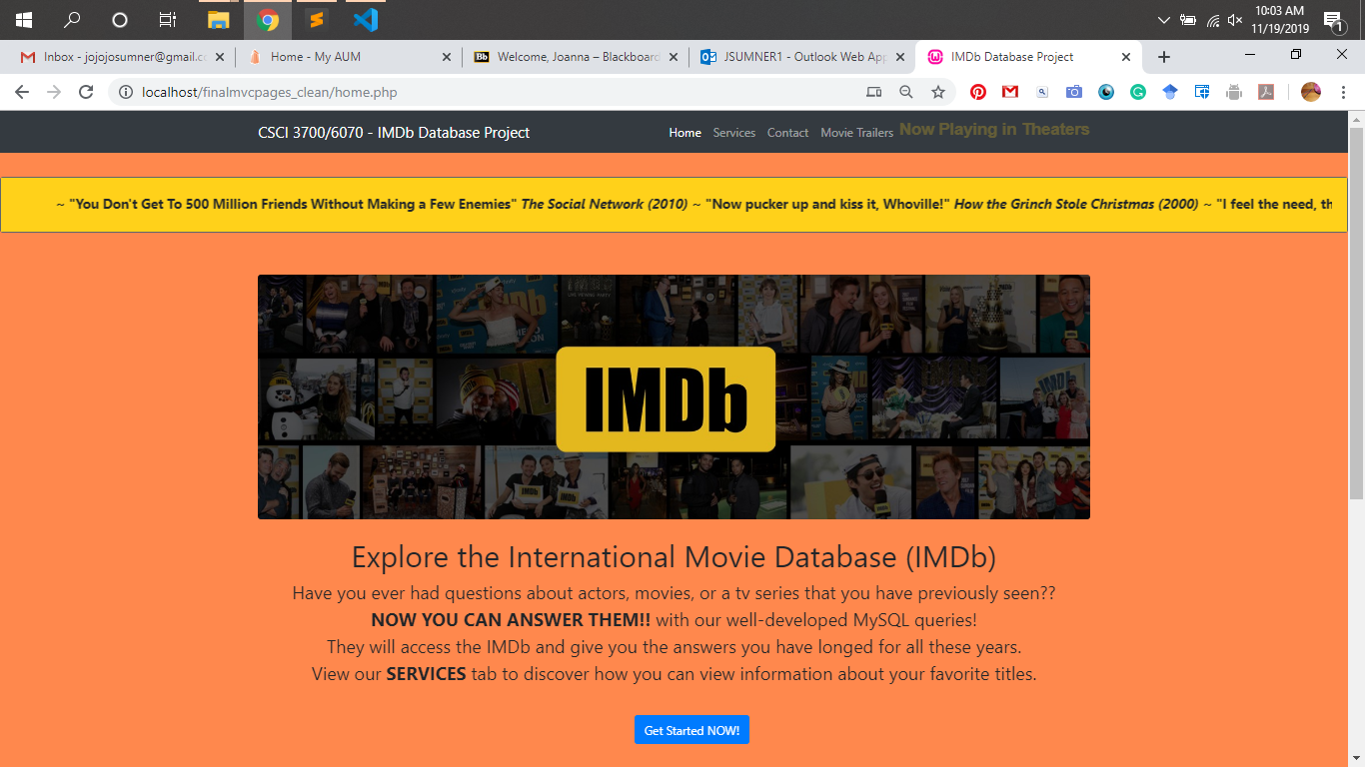
Notes:
Home - top

Slide 16
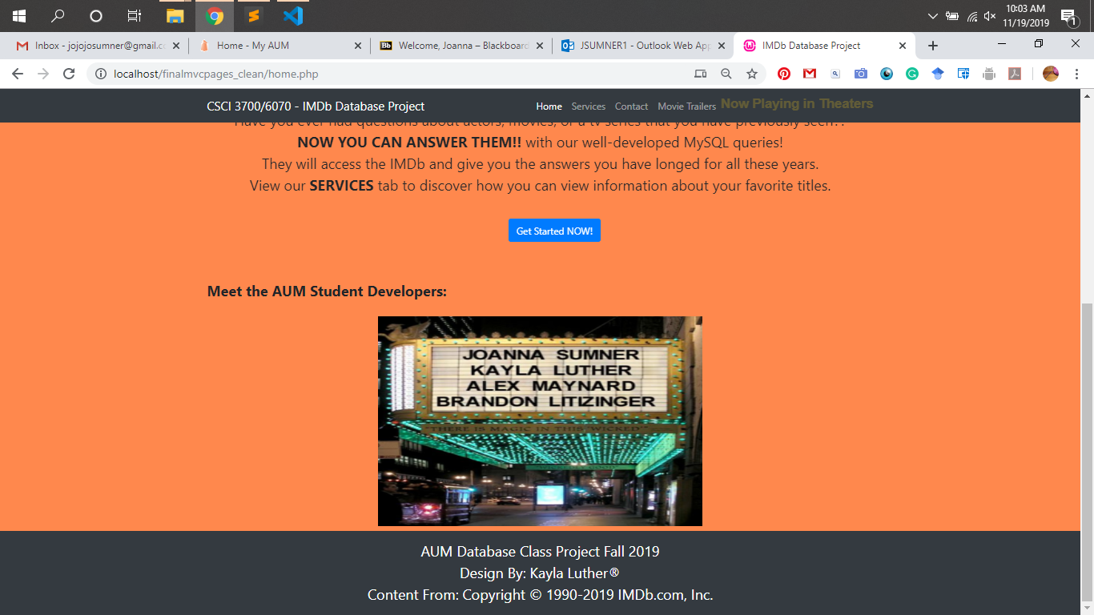
Notes:
Home - bottom

Slide 17
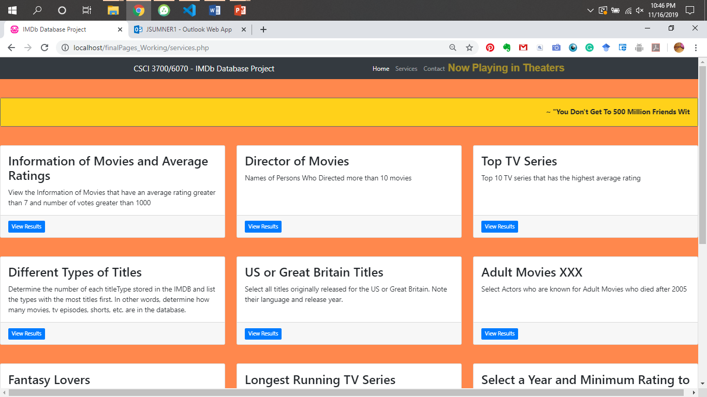
Notes:
Services - Top

Slide 18
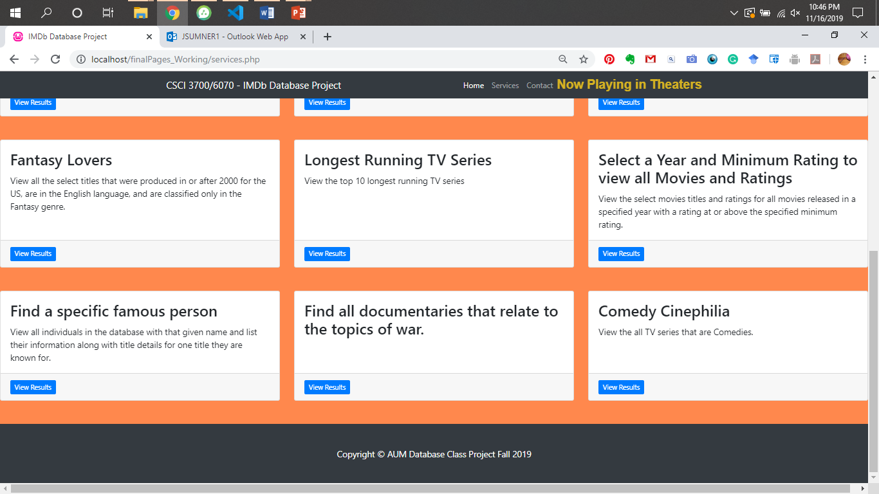
Notes:
Services - Bottom

Slide 19
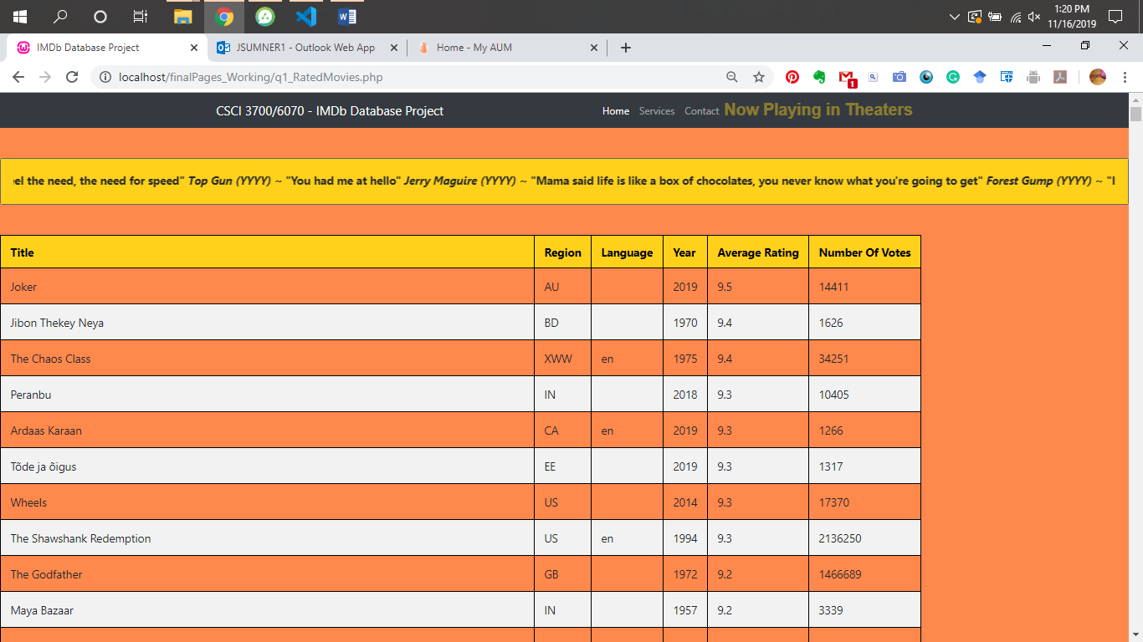
Notes:
Q1: Rated Movies

Slide 20
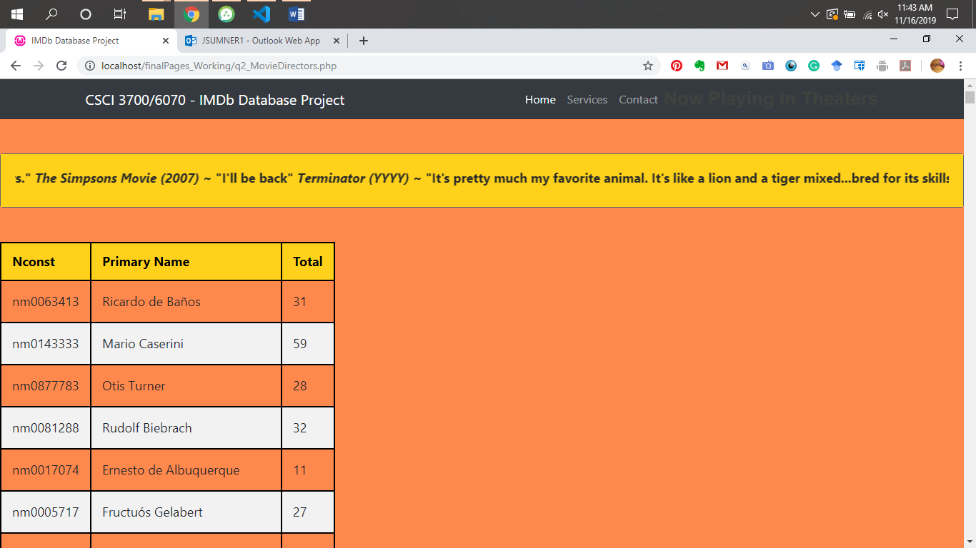
Notes:
Q2: Director Movies

Slide 21
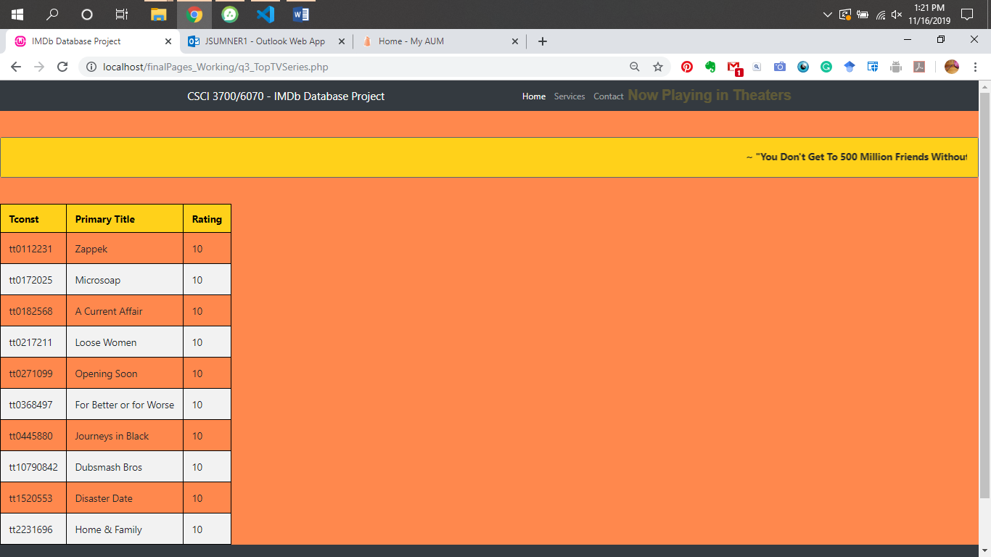
Notes:
Q3: Top TV Series

Slide 22
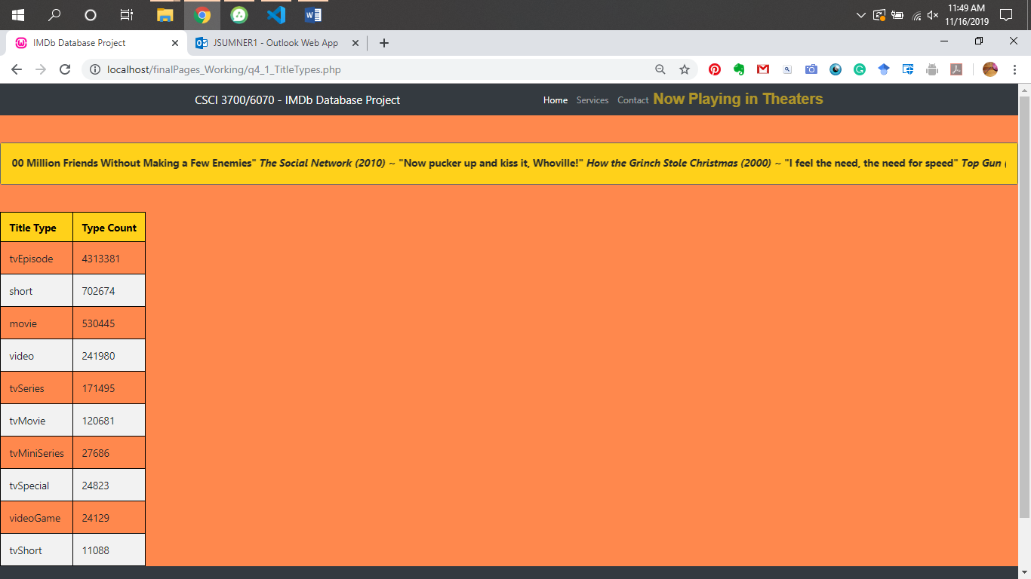
Notes:
Q4.1 Title Type

Slide 23
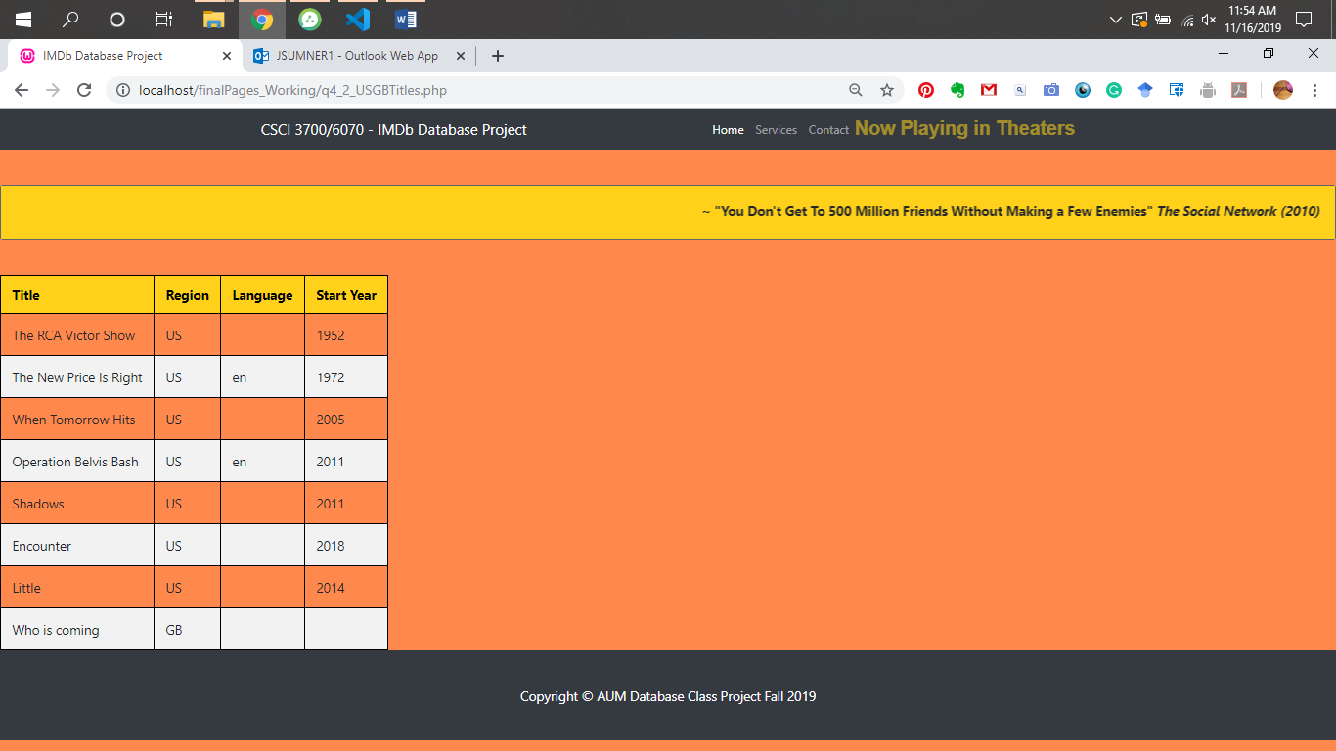
Notes:
Q4.2 US GB Titles

Slide 24
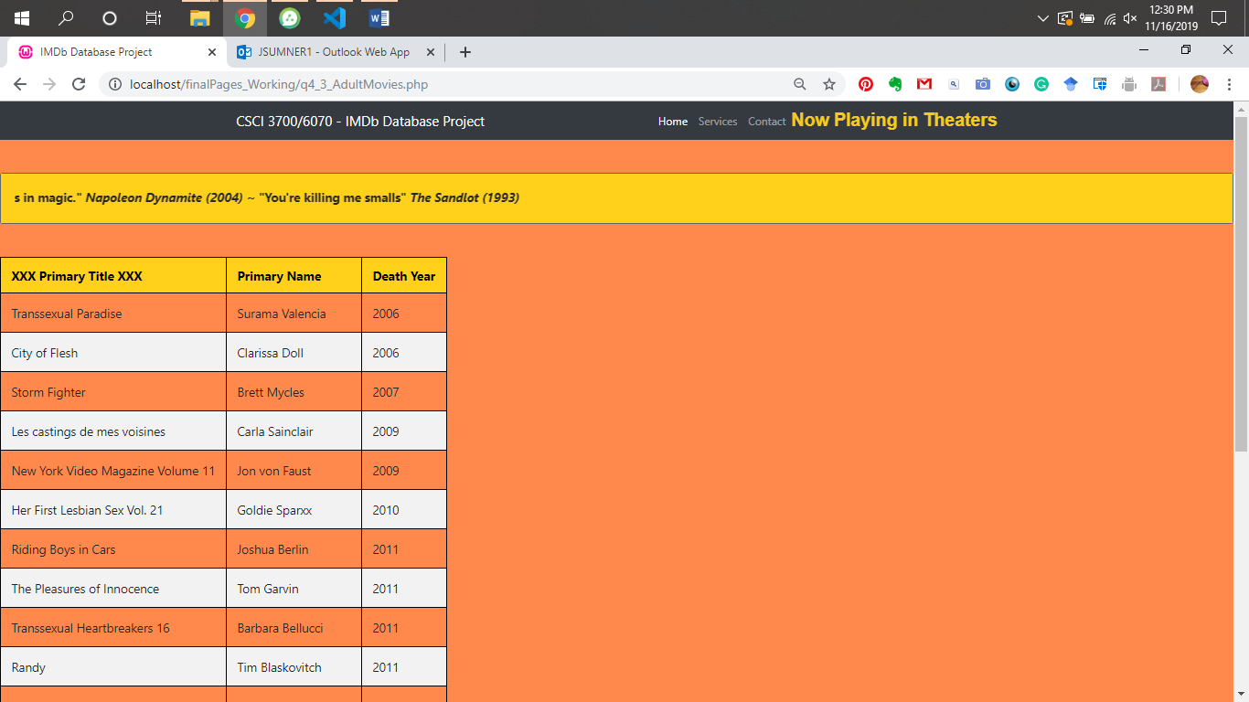
Notes:
Q4.3 Adult Movies

Slide 25
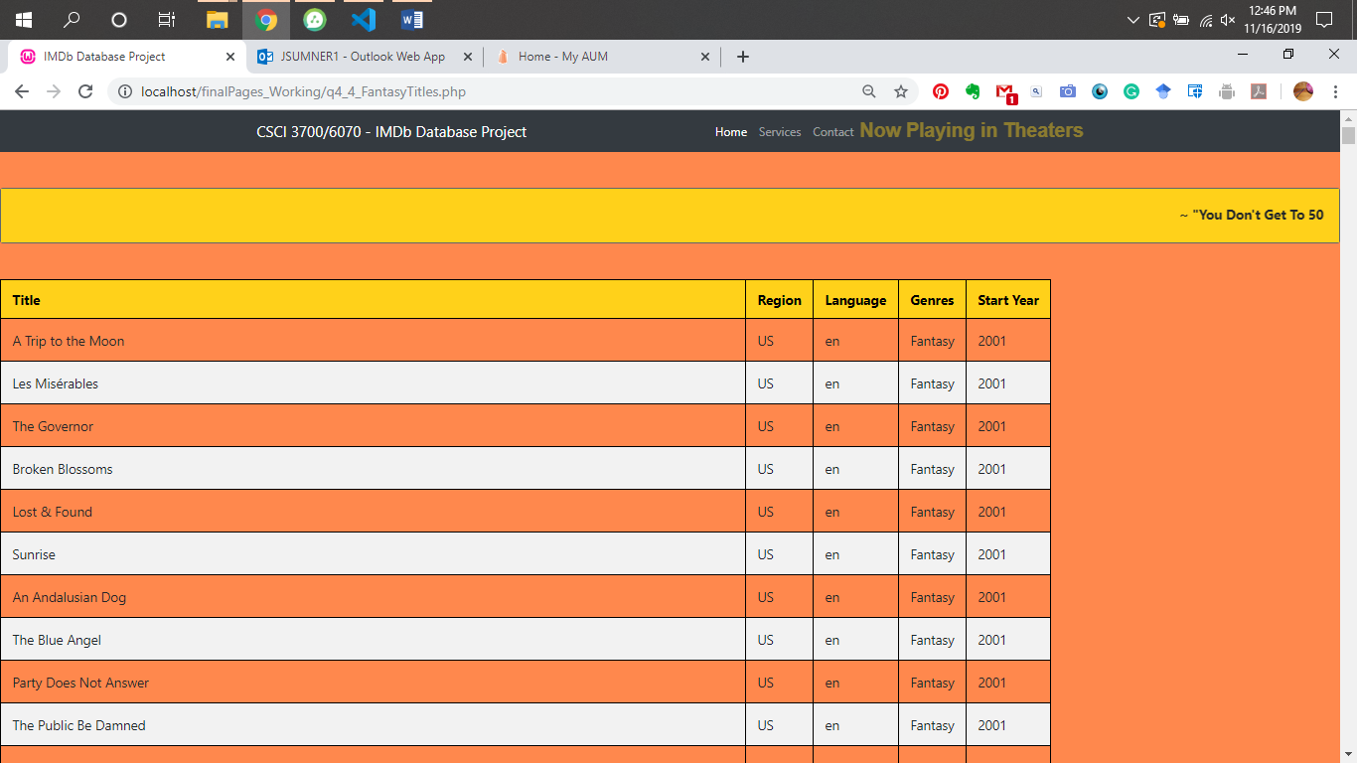
Notes:
Q4.4 Fantasy Titles

Slide 26
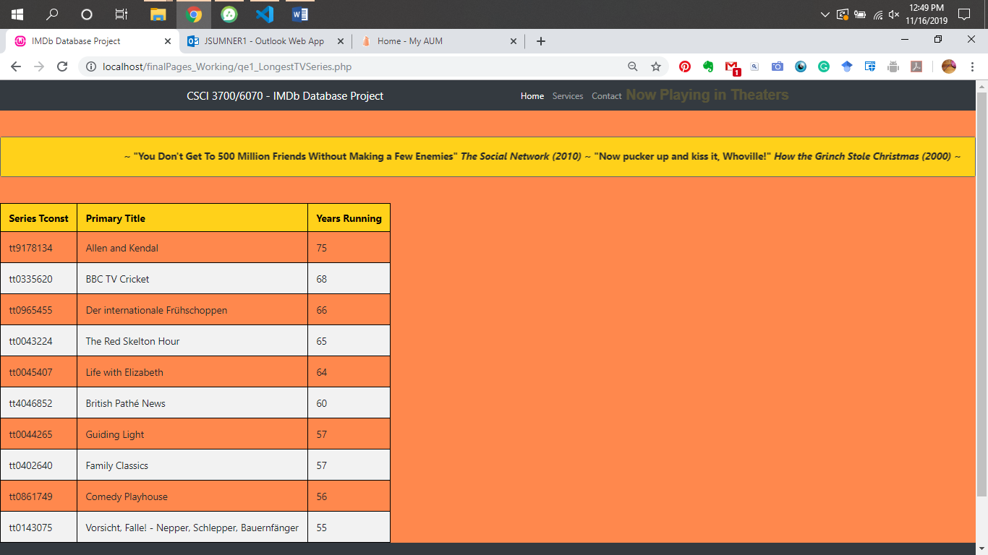
Notes:
Extra Q1: Longest TV Series

Slide 27
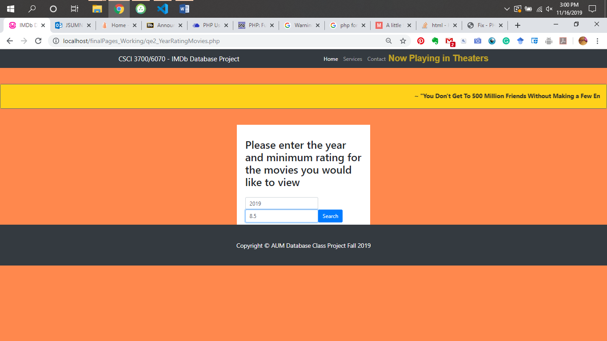
Notes:
Extra Q2: Year Rating Movies - Form

Slide 28
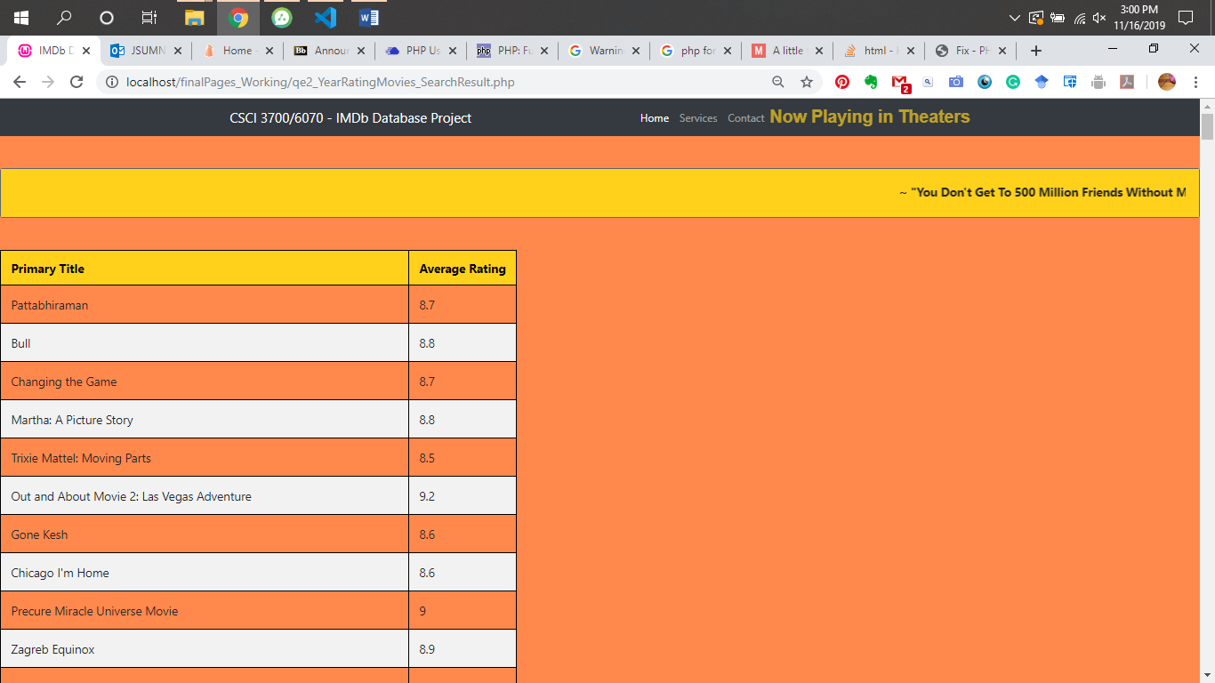
Notes:
Extra Q2: Year Rating Movies - Result

Slide 29
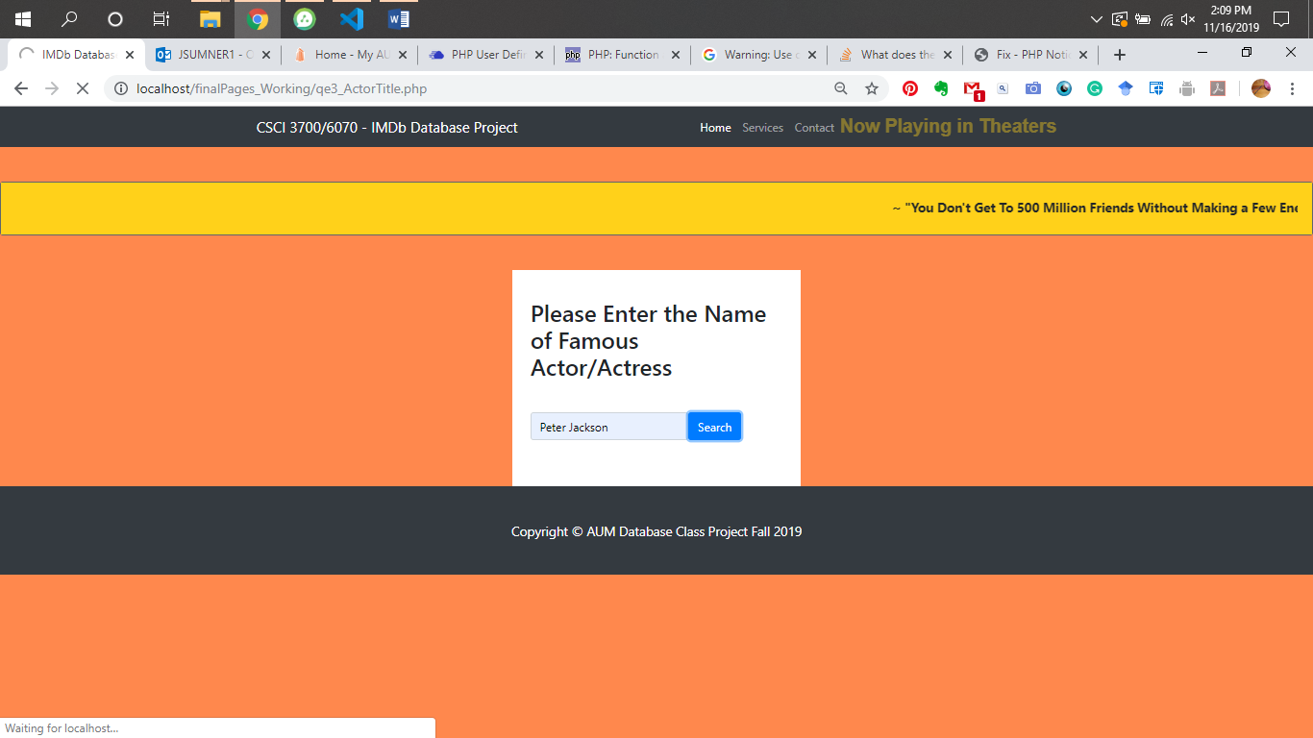
Notes:
Extra Q3: Actor Title - Form

Slide 30
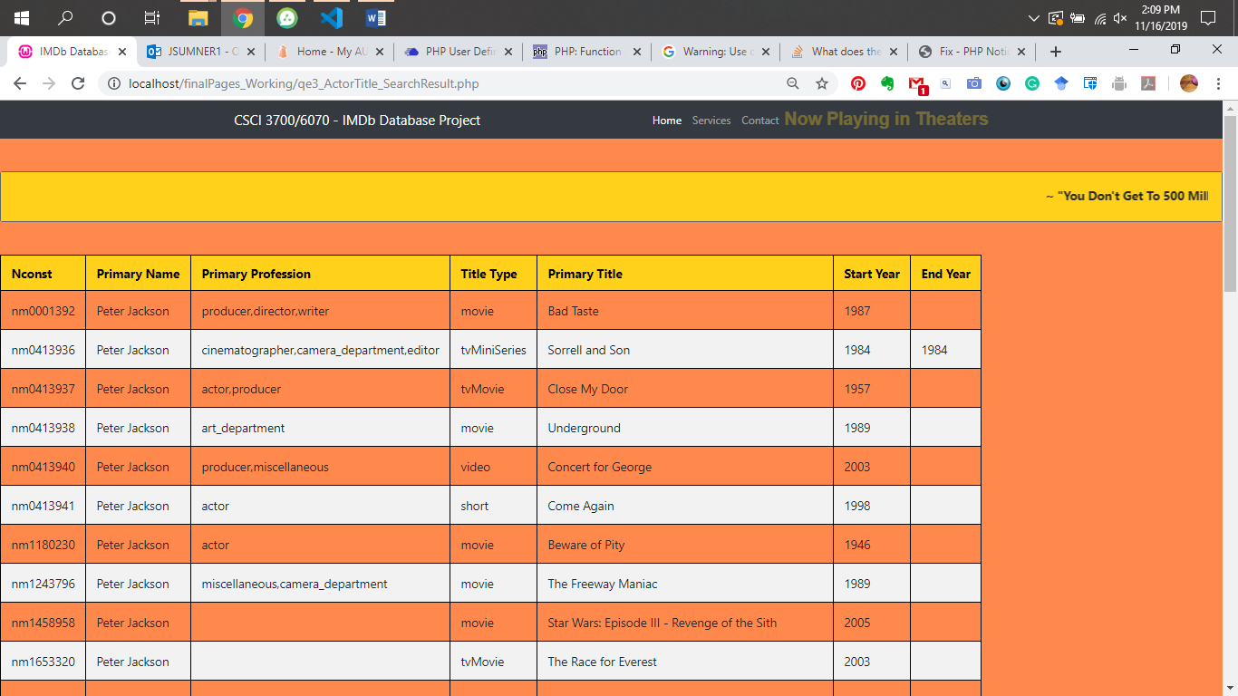
Notes:
Extra Q3: Actor Title - Result

Slide 31
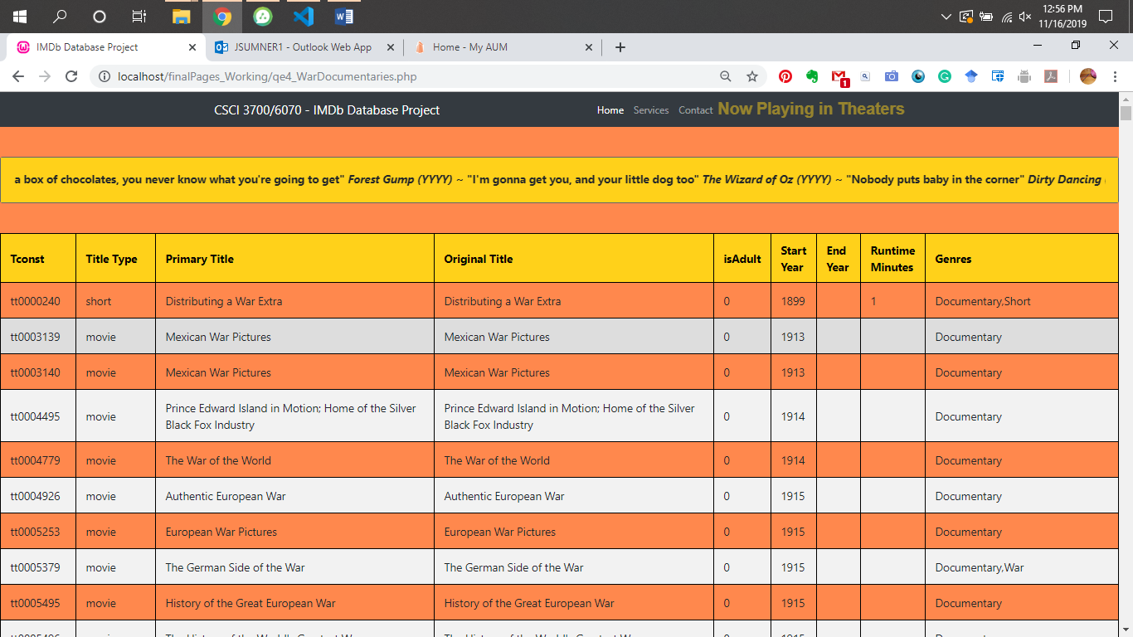
Notes:
Extra Q4: War Documentaries

Slide 32
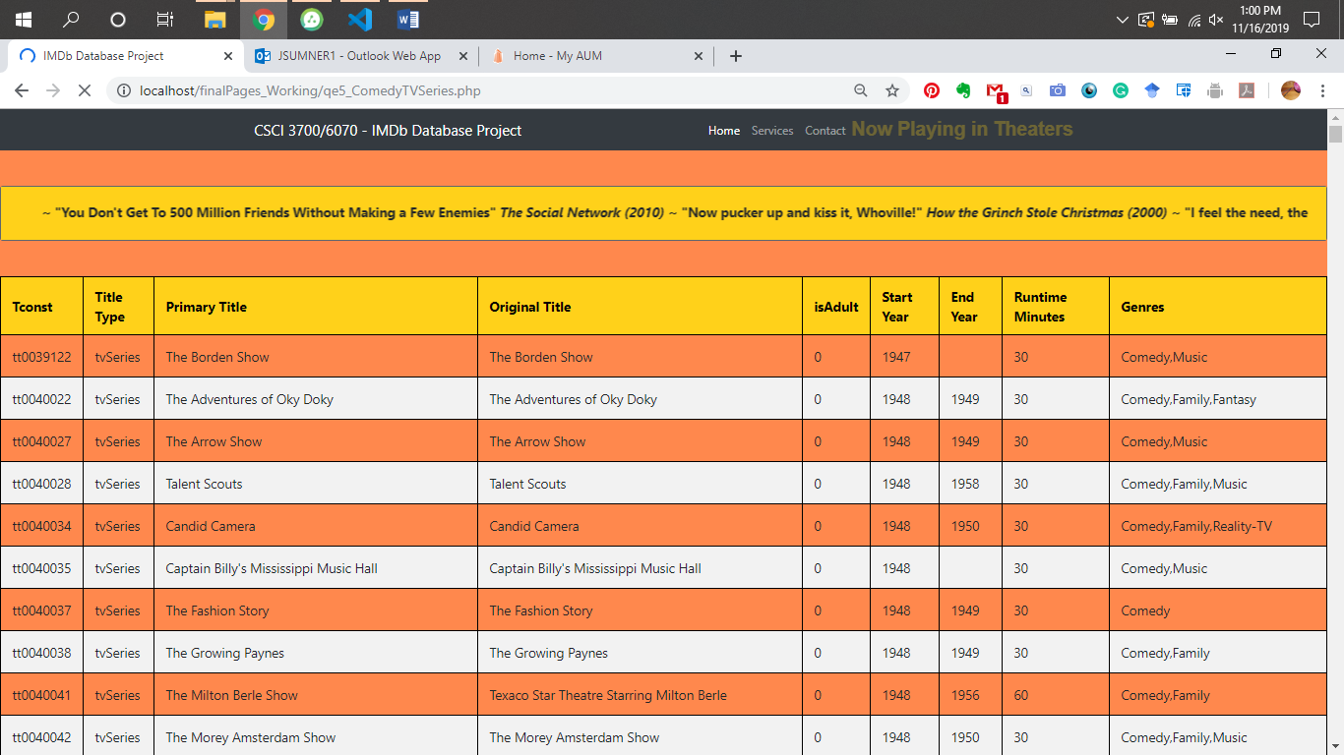
Notes:
Extra Q5: Comedy TV Series

Slide 33
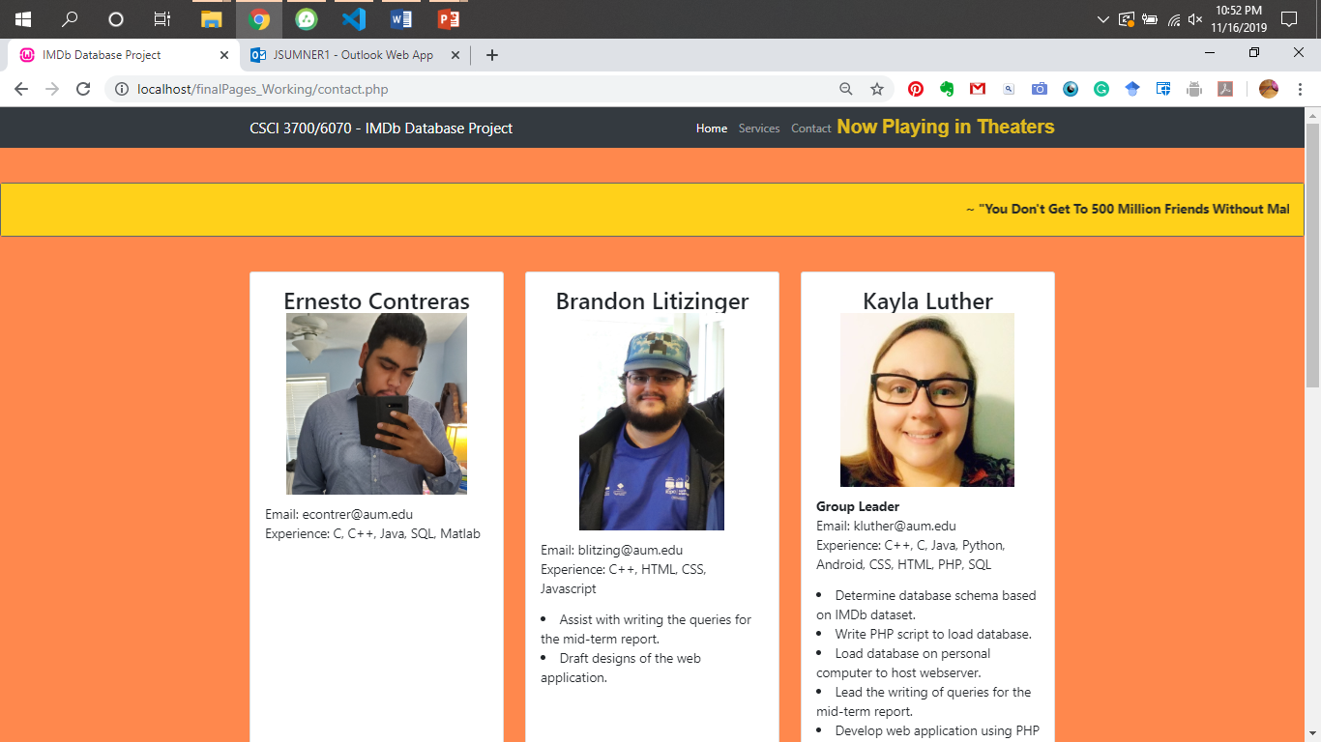
Notes:
Contact - Top

Slide 34
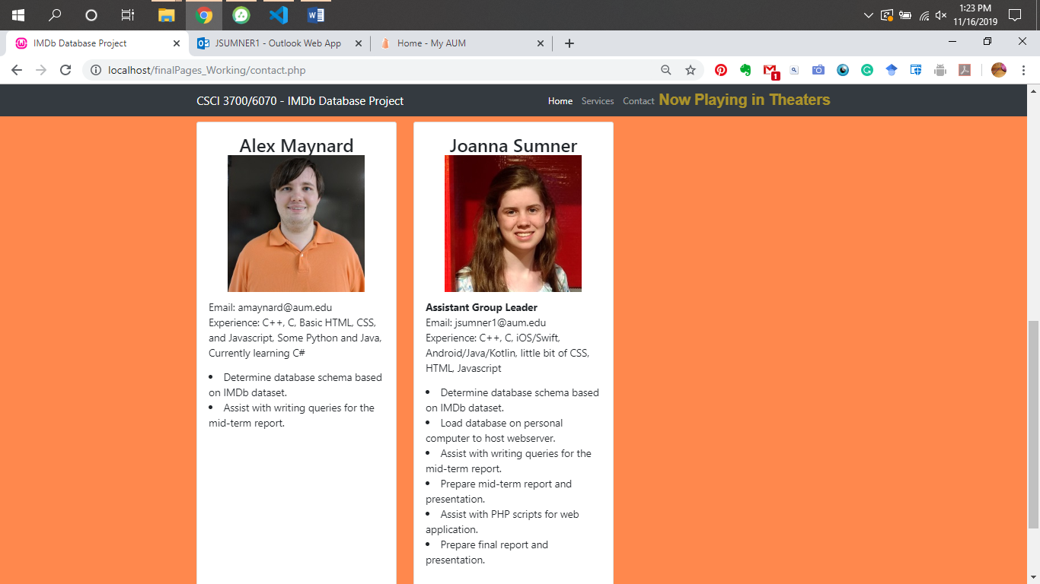
Notes:
Contact - Bottom

Slide 35
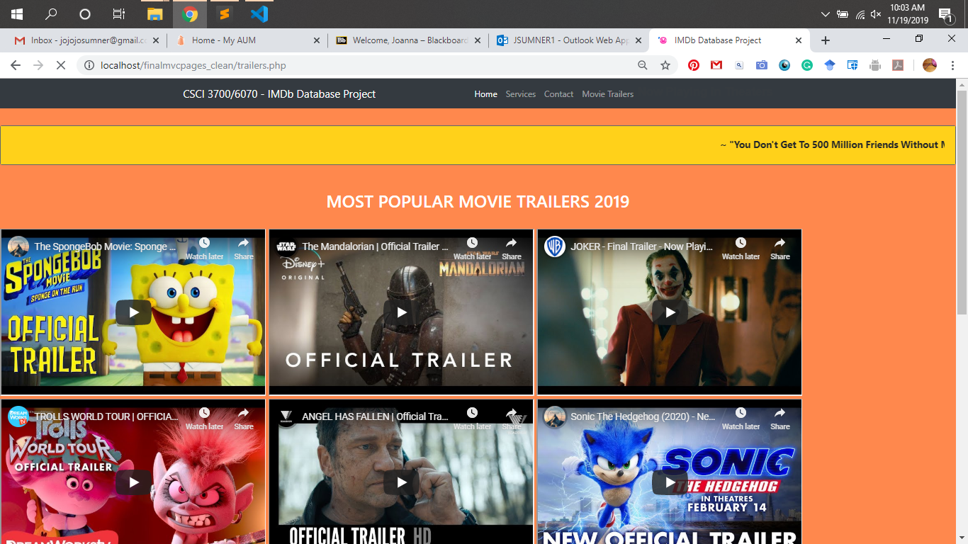

Slide 36
